Slide 1

Operating systems
Introduction
Venkatesh Prasad
Department of Computer Science
Notes:
I am going to introduce Operating System, what they are, what they do and why it’s important.
OS runs on computers, mobiles, gadget and many other devices.
Thorough OS knowledge is required to work on System Software including Compilers and Device Drivers.
Real Time OS is used in embedded systems, TVs, Car/Game Consoles.
Multiple Operating Systems: UNIX, Linux, Windows, Mac OS, Android, Solaris, HP-UX, IBM AIX, BSD

Slide 2
OPERATING SYSTEMS
Slides Credits for all PPTs of this course
The slides/diagrams in this course are an adaptation, combination, and enhancement of material from the following resources and persons:
Slides of Operating System Concepts, Abraham Silberschatz, Peter Baer Galvin, Greg Gagne - 9th edition 2013 and some slides from 10th edition 2018
Some conceptual text and diagram from Operating Systems - Internals and Design Principles, William Stallings, 9th edition 2018
Some presentation transcripts from A. Frank – P. Weisberg
Some conceptual text from Operating Systems: Three Easy Pieces, Remzi Arpaci-Dusseau, Andrea Arpaci Dusseau

Slide 3
OPERATING SYSTEMS
Course Objective(s)
The objective(s) of this course is to:
Provide an insight into the basic organization of computer systems
Familiarize students with various components of an Operating System
Focus on fundamental problems and optimal solutions for resource management in Operating System such as Process, Threads, Disk scheduling and Memory Management
Discuss Storage Management such as the design of a file system on secondary storage and system I/O in depth
Discuss System Protection, System Security and Distributed Systems Basics

Slide 4
OPERATING SYSTEMS
Course Outcome(s)
At the end of this course the student will be able to:
Correlate the different components of an Operating System
Compare and contrast various scheduling algorithms and their performance tradeoffs.
Analyze techniques for system resource management and explore design trade-offs in designing memory components of the Operating system.
Analyze performance issues associated with I/O devices and learn the algorithms & structures used for storage management
Understand the goals and principles of protection in a modern computer system, explore security threats & attacks and understand the roles, types and advantages of distributed systems

Slide 5
OPERATING SYSTEMS
Lecture 1 Objectives
To describe the basic organization of computer systems
To provide a grand tour of the major components of operating systems
To give an overview of the many types of computing environments

Slide 6
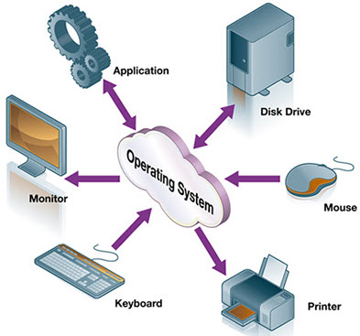
OPERATING SYSTEMS
General Definition
An Operating System is a program that acts as an intermediary between a user of a computer and the computer hardware
It provides a user-friendly environment in which a user may easily develop and execute programs. Otherwise, hardware knowledge would be mandatory for computer programming.

Slide 7
OPERATING SYSTEMS
Operating System Goals
Execute user programs and make solving user problems easier
Make the computer system convenient to use
Use the computer hardware in an efficient manner
Manage resources such as • Memory • Processor(s) • I/O Devices
Notes:
OS manages hardware, allocates resources, controls program execution and provides user program environment

Slide 8
OPERATING SYSTEMS
Why Study Operating Systems?
Only a small percentage of computer practitioners will be involved in the creation or modification of an operating system.
However almost all code runs on top of an operating system, and thus knowledge of how operating systems work is crucial to proper, efficient, effective, and secure programming.
Understanding the fundamentals of operating systems, how they drive computer hardware, and what they provide to applications is essential to those who program them and those who write programs on them and use them.
Notes:
OS manages hardware, allocates resources, controls program execution and provides user program environment

Slide 9
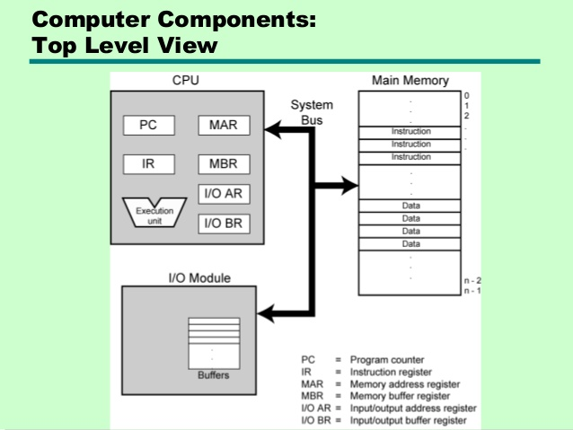
OPERATING SYSTEMS
Basic Elements
Four main structural elements: Processor, Main memory, I/o modules and System Bus

Slide 10
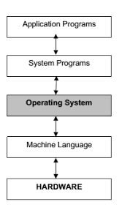
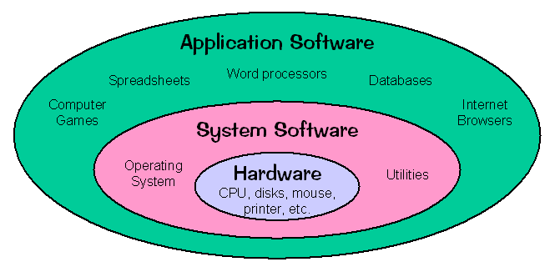
OPERATING SYSTEMS
OS as an Extended Machine
Notes:
Operating System performs two basically unrelated functions: provides a clean abstract set of resources instead of the messy hardware to application programmers and manages these hardware resources. OS provides a set of basic commands or instructions to perform various operations such as read, write, modify, save or close. Dealing with the commands is easier than directly dealing with hardware.

Slide 11
OPERATING SYSTEMS
Computer System Structure
Hardware – provides basic computing resources
CPU, memory, I/O devices
Operating system
Controls and coordinates use of hardware among various applications and users
Application programs – define the ways in which the system resources are used to solve the computing problems of the users
Word processors, compilers, web browsers, database systems, video games
Users
People, machines, other computers
Notes:
Computer system can be divided into four components: Hardware, OS, Application Programs and Users

Slide 12
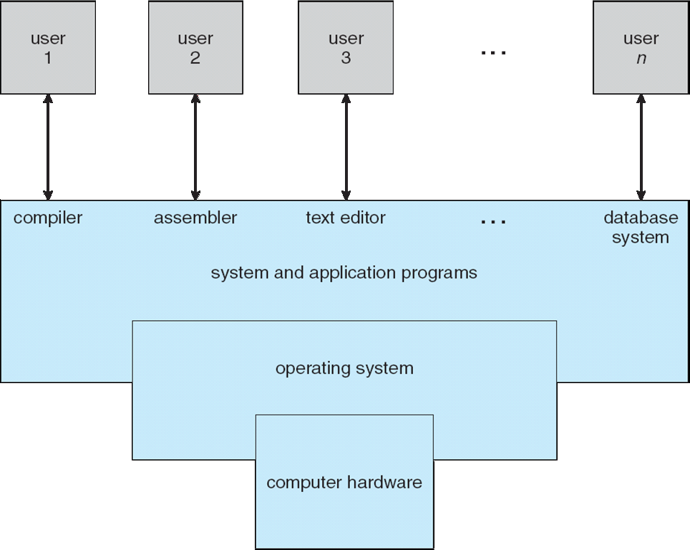
OPERATING SYSTEMS
Four Components of a Computer System (Abstract view)
© copyright Silberschatz, Galvin and Gagne, 2013

Slide 13
OPERATING SYSTEMS
What Operating Systems Do
Depends on the point of view
Users want convenience, ease of use and good performance
Don’t care about resource utilization
But shared computer such as mainframe or minicomputer must keep all users happy
Users of dedicated systems such as workstations have dedicated resources but frequently use shared resources from servers
Handheld computers are resource poor, optimized for usability and battery life
Some computers have little or no user interface, such as embedded computers in devices and automobiles
Notes:
Three conceptual pieces that are fundamental to operating systems: Virtualization (CPU scheduling, Process management, Memory management – Paging & Segmentation), Concurrency (like Threads, locks, condition variables & Semaphores), and Persistence (I/O devices, file systems, storage, data integrity/protection, Distributed Systems, NFS).

Slide 14
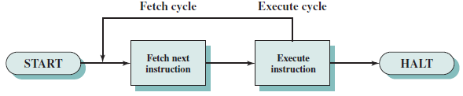
OPERATING SYSTEMS
Program Execution Model
What happens, at the fundamental level, when a program runs?
The processor fetches instructions from memory, decodes and executes them.
The Fetch and Execute cycles are repeated until the program terminates.
This is called the Von Neumann model of computing.

Slide 15
OPERATING SYSTEMS
Operating System Definition
OS is a resource allocator
Manages all resources
Decides between conflicting requests for efficient and fair resource use
OS is a control program
Controls execution of programs to prevent errors and improper use of the computer
“The one program running at all times on the computer” is the kernel.
Everything else is either
a system program (ships with the operating system) , or
an application program.
Notes:
At Computer Startup, bootstrap program (or loader) is loaded at power-up or reboot
Typically stored in ROM or EPROM, generally known as firmware
Initializes all aspects of system
Loads operating system kernel and starts execution

Slide 16
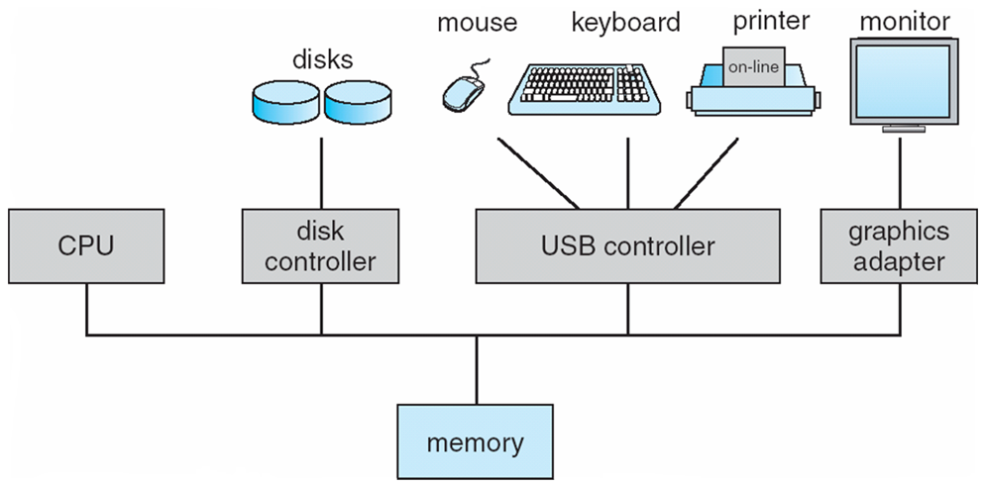
OPERATING SYSTEMS
Computer System Organization
Computer-system operation
One or more CPUs, device controllers connect through common bus providing access to shared memory
Concurrent execution of CPUs and devices competing for memory cycles
© copyright Silberschatz, Galvin and Gagne, 2013

Slide 17
OPERATING SYSTEMS
Computer System Operation
I/O devices and the CPU can execute concurrently
Each device controller is in charge of a particular device type
Each device controller has a local buffer
Each device controller has registers for action (like “read character from keyboard”) to take
CPU moves data from/to main memory to/from local buffers
I/O is from the device to local buffer of controller
Device controller informs CPU that it has finished its operation by causing an interrupt

Slide 18
OPERATING SYSTEMS
Common Functions of Interrupts
Interrupt transfers control to the interrupt service routine generally, through the interrupt vector, which contains the addresses of all the service routines
Interrupt architecture must save the address of the interrupted instruction
A trap or exception is a software-generated interrupt caused either by an error or a user request
An operating system is interrupt driven

Slide 19
OPERATING SYSTEMS
Interrupt Handling
The operating system preserves the state of the CPU by storing registers and the program counter
Determines which type of interrupt has occurred:
polling
vectored interrupt system
Separate segments of code determine what action should be taken for each type of interrupt
Notes:
In a computer, a polled interrupt is a specific type of I/O interrupt that notifies the part of the computer containing the I/O interface that a device is ready to be read or otherwise handled but does not indicate which device. The interrupt controller must poll (send a signal out to) each device to determine which one made the request. Polled interrupt is an inefficient method of data transfer, spending much time checking the ready condition of a computer's devices.
The alternative to a polled interrupt is a vectored interrupt , an interrupt signal that includes the identity of the device sending the interrupt signal.

Slide 20
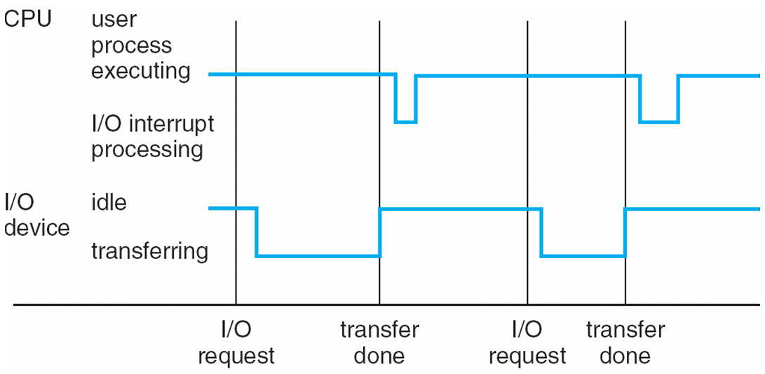
OPERATING SYSTEMS
Interrupt Timeline for a single process doing output
Interrupt processing times vary..
..and so do I/O transfer times

Slide 21
OPERATING SYSTEMS
I/O Structure
After I/O starts, control returns to user program only upon I/O completion
Wait instruction idles the CPU until the next interrupt
Wait loop (contention for memory access)
At most one I/O request is outstanding at a time, no simultaneous I/O processing
After I/O starts, control returns to user program without waiting for I/O completion
System call – request to the OS to allow user to wait for I/O completion
Device-status table contains entry for each I/O device indicating its type, address, and state
OS indexes into I/O device table to determine device status and to modify table entry to include interrupt

Slide 22
OPERATING SYSTEMS
Storage Structure
Main memory – only large storage media that the CPU can access directly (Random access and Typically volatile)
Secondary storage – extension of main memory that provides large nonvolatile storage capacity
Hard disks – rigid metal or glass platters covered with magnetic recording material
Disk surface is logically divided into tracks, which are subdivided into sectors
The disk controller determines the logical interaction between the device and the computer
Solid-state disks – faster than hard disks, nonvolatile
Various technologies and becoming more popular

Slide 23
OPERATING SYSTEMS
Storage Hierarchy
Storage systems organized in hierarchy
Speed
Cost
Volatility
Caching – copying information into faster storage system; main memory can be viewed as a cache for secondary storage
Device Driver for each device controller to manage I/O
Provides uniform interface between controller and kernel

Slide 24
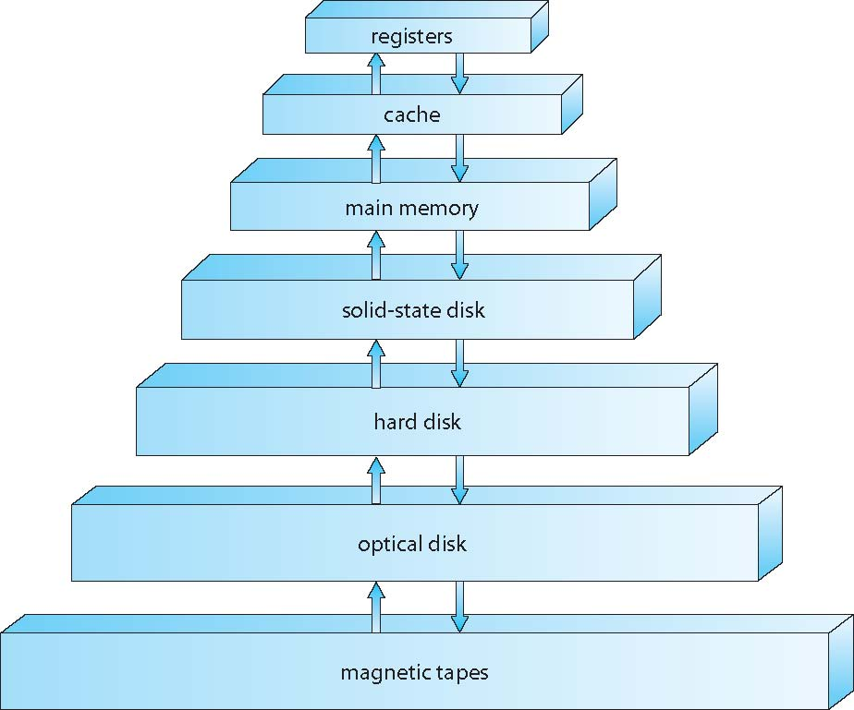
OPERATING SYSTEMS
Storage-Device Hierarchy

Slide 25
OPERATING SYSTEMS
Caching
Important principle, performed at many levels in a computer (in hardware, operating system, software)
Information in use copied from slower to faster storage temporarily
Faster storage (cache) checked first to determine if information is there
If it is, information used directly from the cache (fast)
If not, data copied to cache and used there
Cache smaller than storage being cached
Cache management important design problem
Cache size and replacement policy

Slide 26
OPERATING SYSTEMS
Direct Memory Access Structure
Used for high-speed I/O devices able to transmit information at close to memory speeds
Device controller transfers blocks of data from buffer storage directly to main memory without CPU intervention
Only one interrupt is generated per block, rather than the one interrupt per byte

Slide 27
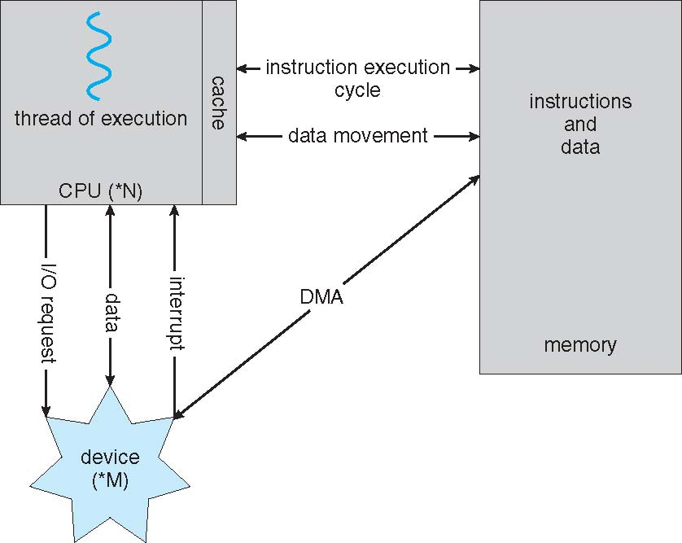
OPERATING SYSTEMS
How a modern computer system works

Slide 28

THANK YOU
Venkatesh Prasad
Department of Computer Science Engineering
venkateshprasad@pes.edu

